Slide 1

Passerelles numériques
A Gateway for Life
Introduction

Slide 2
Outline
Composer
Install Laravel
MVC
File structure

Slide 3

Composer
What is composer?
How to install composer ?

Slide 4

1. What is composer?
Composer is a tool for dependency management in PHP. It allows you to declare the libraries your project depends on and it will manage (install/update) them for you.

Slide 5
Video
https://www.youtube.com/watch?v=E8omrqGJWSw

Slide 6
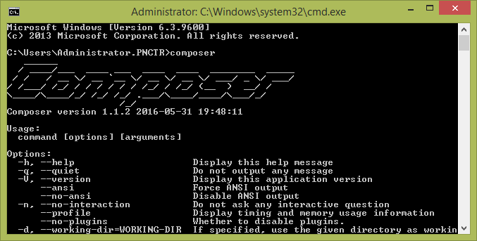
2. Composer installation
Go to https://getcomposer.org/download/
Download the .exe file
Click run to install
Start+R and type cmd, then type “composer”
Notes:
Type “composer” in cmd to make sure that composer is installed

Slide 7

Create New Project
How to setup a very basic project with laravel?

Slide 8
https://laravel.com/docs/5.7

Slide 9
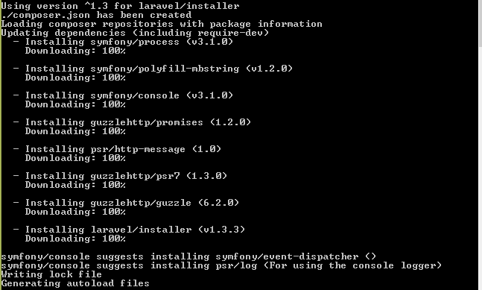
1. Create new Project
First, download the Laravel installer using Composer:
composer global require "laravel/installer"

Slide 10
1. Create new Project (Cont.)
Once installed, the laravel new command will create a fresh Laravel installation in the directory you specify.
laravel new blog
Project name
Key word to create new project
Using laravel command
Notes:
Alternatively, you may also install Laravel by issuing the Composer create-project command in your terminal:
composer create-project --prefer-dist laravel/laravel blog

Slide 11

2. Serving Laravel
Typically, you may use a web server such as Apache or Nginx to serve your Laravel applications. If you are on PHP 5.4+ and would like to use PHP's built-in development server, you may use the serve Artisan command:
Ctrl + c to stop running the server

Slide 12
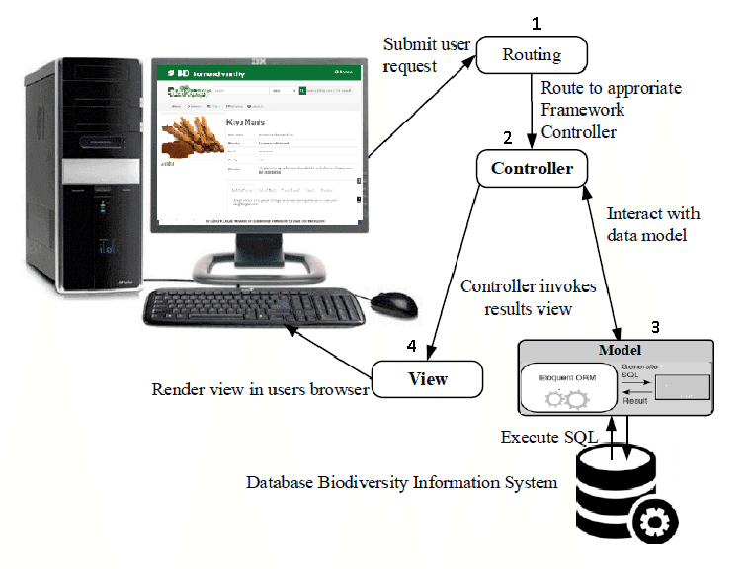
MVC

Slide 13

File structure

Slide 14
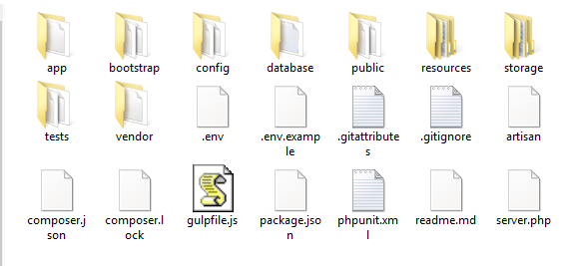
File Structure https://laravel.com/docs/5.7/structure
Notes:
App: directory, as you might expect, contains the core code of your application. Store models.
Bootstrap: folder contains a few files that bootstrap the framework and configure autoloading, as well as a cache folder that contains a few framework generated files for bootstrap performance optimization.
Database: folder contains your database migration and seeds. If you wish, you may also use this folder to hold an SQLite database.
The public: directory contains the front controller and your assets (images, JavaScript, CSS, etc.).
The resources directory contains your views, raw assets (LESS, SASS, CoffeeScript), and localization files.
The storage directory contains compiled Blade templates, file based sessions, file caches, and other files generated by the framework. This folder is segregated into app, framework, and logsdirectories.
The tests directory contains your automated tests. An example PHPUnit is provided out of the box.
The vendor directory contains your Composer dependencies.
See here: https://laravel.com/docs/5.7/structure

Slide 15
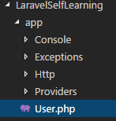
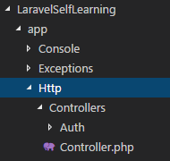
app folder
Stores models
Stores controllers
Http/Contollers

Slide 16
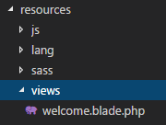
resources
views folder
.blade.php: blade template engine

Slide 17
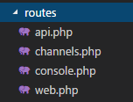
routes
web.php: URL to open the view

Slide 18
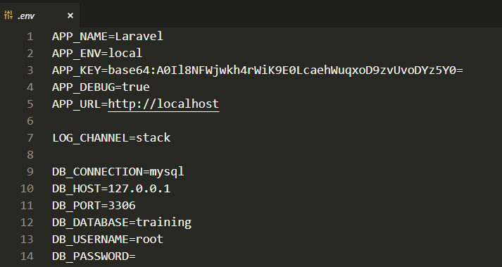
.env
Notes:
env //it will look into .env first then config. Email config
APP_Name = training
App_url: http://localhost/training
use during develop but not on production
it has priority and will ignore config folder and no body see it when we push into git coz it is ignore

Slide 19

database folder

Slide 20
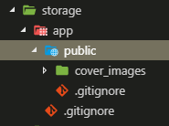
storage
storage: temporary store all upload files

Slide 21
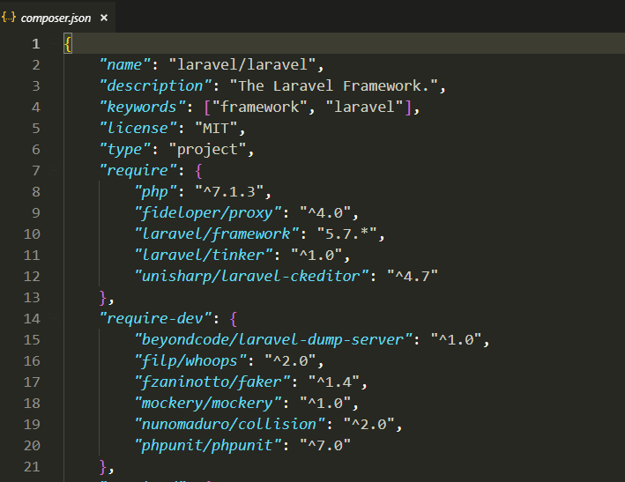
composer.json
composer.json //all libraries to run the project on production

Slide 22
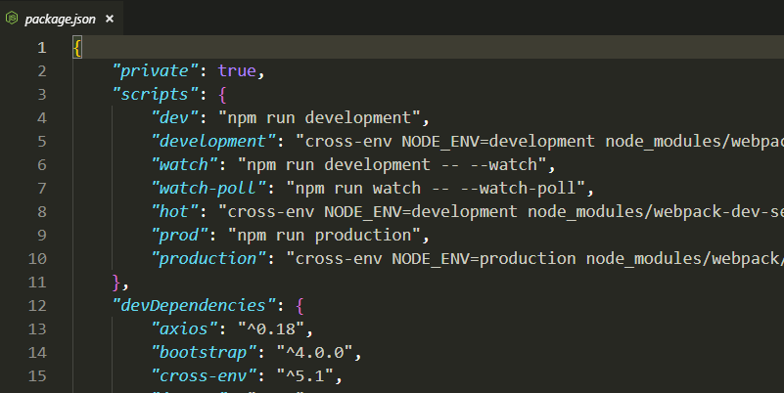
package.json
package.json: used by npm like javascript library

Slide 23
Virtual Host
Edit two files
Xampp\apache\conf\extra\httpd-vhosts.conf
<VirtualHost *:80>
DocumentRoot "E:/xampp/htdocs/LaravelSelfLearning/public"
ServerName LaraSelf.dev
</VirtualHost>
<VirtualHost *:80>
DocumentRoot "E:/xampp/htdocs"
ServerName localhost
</VirtualHost>
Browse to this file open with notepad as administrator C:\Windows\System32\drivers\etc\hosts
127.0.0.1 LaraSelf.dev
127.0.0.1 localhost

Slide 24

Question?
Google.com

